Slide 1
CARTOONIFY IMAGE

Slide 2
TABLE OF CONTENT
ABSTRACT
REQUIREMENTS
OPEN CV
METHODOLOGY
NORMAL IMAGE TO GREYSCALE IMAGE
EXPECTED OUTCOME

Slide 3
ABSTRACT
Image Processing
–
In the field of the research processing of an image consisting of identifying an object inan image, identify the dimensions, no of objects, changing the images to blur effect and such effects arehighly appreciated in this modern era of media and communication.There are multiple properties in theImage Processing. Each of the property estimates the image to be produced more with essence and sharperimage.Each Image is examined to various grid. Each picture element together is viewed as a 2-D Matrix.With each of the cell store different pixel values corresponding to each of the picture element.

Slide 4
REQUIREMENTS
Python: We use python as a programming language for building the application.
OpneCV: We use OpneCV for image processing.
Numpy: Mainly NumPy is used for dealing with arrays. Here the images that we use are stored in the form of arrays. So for that, we use NumPy.
easygui: easygui is a module used for GUI programming in python. In our application easygui is used to open the file box to upload images from the local system.
Imageio: Imageio is a python library that reads and writes the images.
Matplotlib: Matplotlib is used for visualization purposes. Here we plot the images using matplotlib.
OS: Here in our application OS is used for dealing with paths like reading images from the path and saving the image to the path.

Slide 5
OPENCV
OpenCV is an open-source library in python that is used mainly for computer vision tasks in the areas of machine learning and artificial intelligence. Nowadays, openCV is playing a major role in the field of technology. Using OpenCV we can process images and videos for some tasks like object detection, face detection, object tracking, and all.
OpenCV has c, c++, java, and python interfaces and it supports all kinds of systems such as Windows, Linux, Android, Mac OS, IoS, and all…

Slide 6
METHODOLOGY
UPLOAD IMAGE
TO GREYSCALE
SMOOTHENING
RETRIEVE EDGES
MASK IMAGE
CARTOON EFFECT

Slide 7
METHODOLOGY
This is the methodology that we are going to follow to build our cartoonify application. First of all using easygui, we will upload the image, and then the image is converted to a greyscale image.
The next two steps are the important steps to converting images into cartoon images. They are smoothening and then retrieving the edges. In this color of the image is smoothened to give the cartoon look and then we retrieve the edges and then highlight them in the final image.
Next, we will prepare a mask Image. In this, we use the bilateral filter with removes the noise and smoothen it to some extent. Now the final step is giving the cartoon effect. To the image which we got in the previous step, we combine our two important steps and finally give a mask-edged image that looks like a cartoon image.

Slide 8
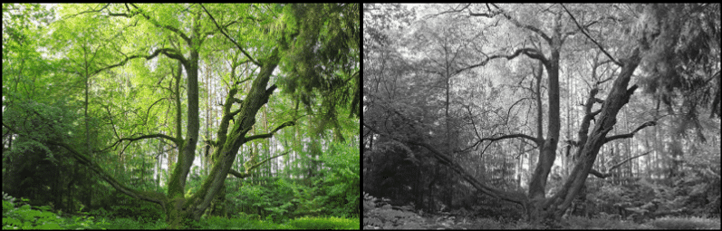
NORMAL IMAGE TO GREYSCALE IMAGE

Slide 9
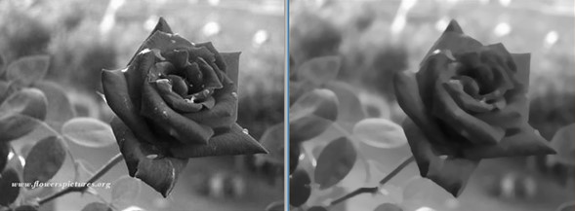
GREYSCALE IMAGE to smoothened image

Slide 10
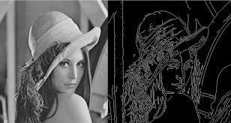
smoothened image to retrieved edge image

Slide 11
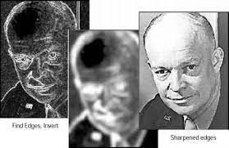
retrieved edge image to masked image

Slide 12
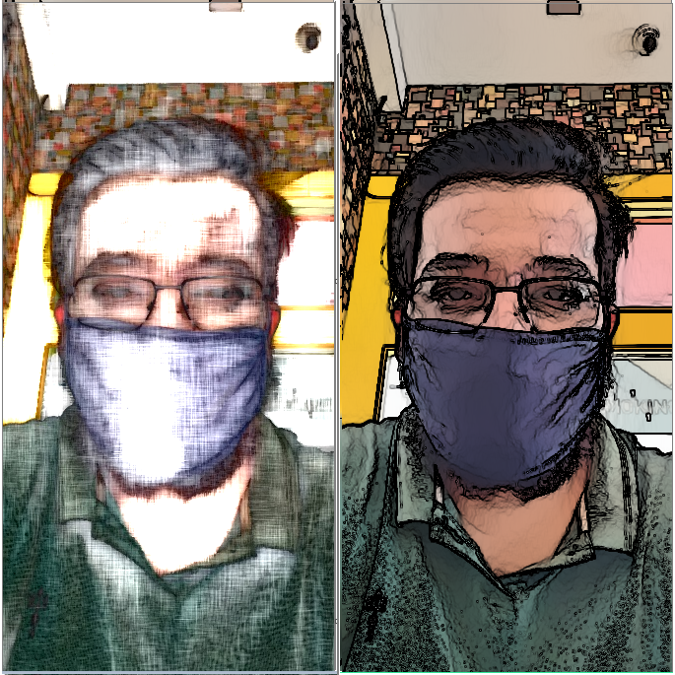
masked image to cartoon effect

Slide 13
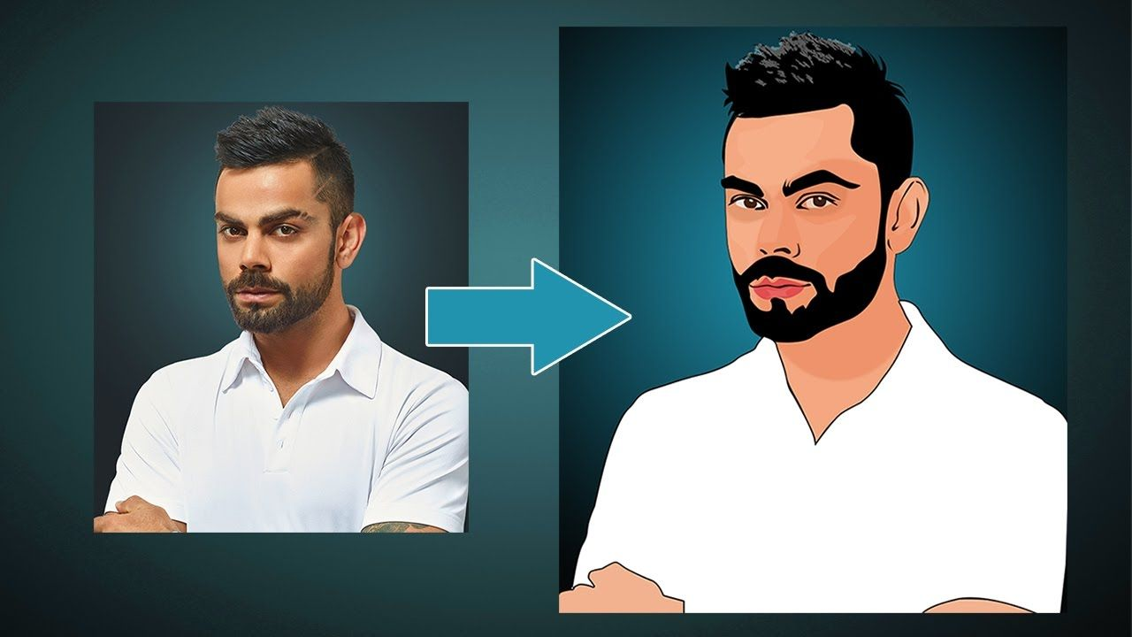
EXPECTED OUTCOME

Slide 14
Thank you
Mentored by : MS. SREYA
Presented by : SIMPAL CHAURSIYA
VIKRANT SINGH
SARANSH SINGH
SUNDRAM JHA

